Slide 1
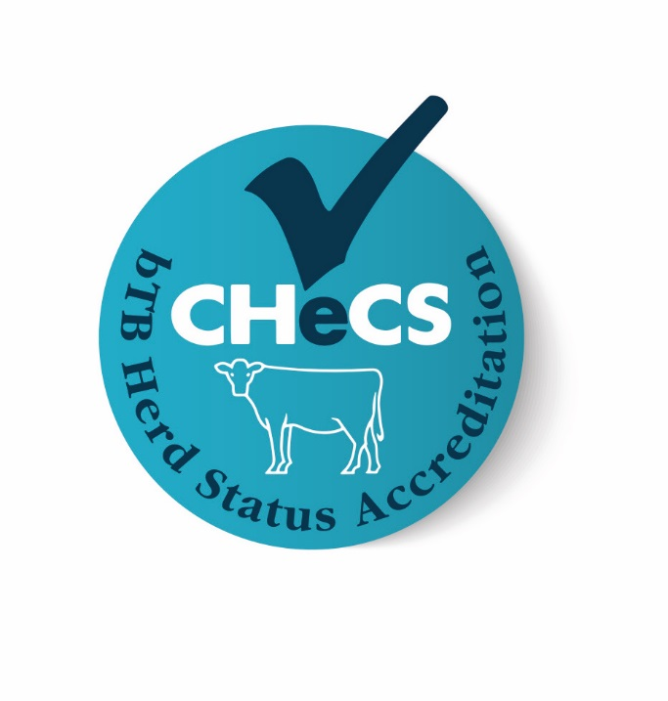
CHeCS: Bovine TB Accreditation
November 2016

Slide 2
Cattle Health Certification Standards (CHeCS)
Self regulatory body for UK cattle health schemes
Established late 1999; non-trading organisation
Sets standards for control and eradication of non-statutory diseases to which all licensed health schemes must adhere
Herd health status in one scheme equivalent to that in all other schemes
Licensed schemes in UK compatible with those in other countries

Slide 3
CHeCS is not itself a
Cattle Health Scheme
It is a regulatory body for Cattle Health Schemes
Stamp of approval and quality mark signifying conformity to an industry standard
Each participating scheme has to agree to the contents of the Technical Document, updated annually
All participating labs for all tests work to ISO 17025
Very close liaison with Animal Health Ireland (AHI)

Slide 4
CHeCS Schemes Growth
In 2004 only around 1% of UK herds were in a CHeCS scheme
2007 – 4.4% cattle farmers were members of CHeCS accredited schemes
In 2012,13,500 -14,000 herds in some form of monitoring, control and eradication under a CHeCS accredited scheme (around 14% of cattle holdings)
Dairy : Beef split – 40 : 60
Pedigree breed societies key players (~75% of members currently pedigree)

Slide 5
Uptake of Cattle Health Schemes
Example: SAC Premium Cattle Health Scheme now has over 5000 UK members:
  55% in Scotland
  23% in England
  20% in Wales
  2% in Ireland

Slide 6
Bovine TB accreditation - the basics
Voluntary
Supported by Defra, Welsh Government
Developed with BCVA and help of APHA
Replaces APHA risk scoring (now on hold)
Uses CHeCS’ expertise/track record in disease reduction
Considers learnings on both CHeCS Johne’s risk scoring & New Zealand bTB certification
Herd vet is integral

Slide 7
History
First investigated in 2014
Various obstacles
Launch date May, then October, now 28 November
Still finalising technical standard
Communication:
  Just started due to delays
  Vets: BCVA Congress 20 October, follow-up emailing, Vet Record etc
  Pedigree beef: NBA pedigree societies group 24 October
  TB Eradication Action Group (TBEAG): 27 October
  Next: TB implementation group for RBT/biosecurity, NFUs, AHDB, LAA/IAAS, CLA, TFA, breed societies, assurance, supply chains, retailers and processors, researchers.

Slide 8
Theory behind the programme
In 2015, Amie Adkins examined the risk of a herd contracting bTB. She found the risk decreased up until year 10, after which the time since the last breakdown had no impact on likelihood of suffering another breakdown.
While risk decreased with the passing of each year, Amie categorised the risk into brackets of 0-2 years, 2-6 years, 6-10 years, then 10+ years.

Slide 9
Theory behind the programme
In 2015, APHA sought to identify origin of infection and route of entry:
Breakdowns in Edge area: purchased cattle 36%; local exposure 45%
Breakdown in Low Risk area: purchased cattle 70%
No data for the High Risk Area but likely to be similar to Edge area
Indirect contact is important and likely the main route for infection in High Risk and Edge areas
If indirect routes can be identified & addressed, there is more opportunity to prevent infection through targeted biosecurity

Slide 10
How it works
Herd Level scoring (not individual animals)
Similar to NZ, but with added requirements for biosecurity
Herd Status 0 is OTF but less than a year since the last herd breakdown – therefore lowest status/most risk
Herd Status 1 is between one and two years since the last herd breakdown…and so on
Herd Status 10 is 10 years or more since the last herd breakdown – therefore highest status/least risk
So in summary, dependent on meeting CHeCS standards and number of years since last breakdown

Slide 11
Signing up new members
Cattle farmer & herd vet discuss/farmer decides to join
Health Scheme requests & receives certification of CHeCS compliance from herd vet
Health Scheme awards starting score
Farmer contacts participating Health Scheme
Health Scheme creates accreditation certificate (valid for 12 months or until date of next test, whichever is first)
APHA places ‘flag’ on holding & sends farm’s 10-year test data back to Health Scheme
Health scheme sends farmer membership form including privacy agreement, which is completed & returned
Membership form & privacy agreement sent to APHA by Health Scheme
Health Scheme notifies starting score to farmer via certificate

Slide 12
Benefits farmers …
In high risk areas with low-risk holdings
In lower/lowest risk areas who want to ‘accredit’ a beneficial status or risk level
Buying in livestock who want to minimise exposure of herd to bTB infection
Already in CHeCS schemes who would like to include bTB
Who want to support Government and industry efforts

Slide 13
How does CHeCS bTB programme differ from statutory measures?
Breakdowns in quarantine are recognised as not impacting herd
Pre-movement testing required if low risk animal has ever been in a higher risk area
Post-movement testing also required for animals moving from
  High risk area -> high risk area
  Low risk area -> low risk area
Statutory rules still apply…but could be shaped by CHeCS in future through earned recognition

Slide 14
Role of vets
Apply CHeCS standards to farm
  Develop and implement health plan
  Ensure quarantine and biosecurity measures met
  Make annual declaration about compliancy
Pre- and Post-movement skin test
Potentially gamma-interferon test (England, under licence) if helpful to management of disease
Confirm any added animal breakdowns taking place in appropriate quarantine

Slide 15
Cost implications
Annual fee likely to be low - £double digits per herd flat rate
Involvement in other CHeCS schemes will dilute test vet call out costs
In extra Pre- and Post-movement testing:
  Can combine with other tests
  Can combine with statutory testing
  Can add animals in larger batches
Vet biosecurity declaration – based on knowledge of business but some inspection of facilities/boundaries may be needed

Slide 16
What stage are we at now?
Launches 28 November with George Eustice on Bristol farm
PCHS and HiHealth Health Schemes currently involved
Data comes direct from APHA Sam database when tests results posted
Data transfer trials still underway
  APHA Sam -> Health Schemes
  Initially 10-year test records to set start risk level
  Then updates Health Scheme as new test results notified
‘Early adopter’ farmers on board – currently 6, aiming for 10-12

Slide 17
Reasons for industry to get involved
Before launch
Help test processes and data transfer
Early adopting herds will help increase uptake of programme
Regional and ‘situational’ case studies for PR
In general
Opportunity to influence the future and avoid regulation
Get back some control
Some herds will benefit greatly

